Slide 1
Moraga School District Citizens Bond oversight committee
January 9, 2018

Slide 2
The law
Before Nov. 7, 2000: School district GOBs could be issued only following a 2/3 vote
After Nov. 7, 2000: Prop. 39 on Statewide ballot changed law to permit School District GOBs if approved by a 55% vote
55% Vote Requires Accountability
More success for facility funding due to lower vote threshold
Accountability: Each successful Prop. 39 election results in the formation of a related Citizens’ Oversight Committee and requires the District to cause the production of Bond Financial and Performance Audits

Slide 3
Lawmakers’ Stated Intent
Vigorous efforts are undertaken to ensure that the expenditure of bond proceeds are legal
Taxpayers directly participate in the oversight of bond expenditures
Members of COCs promptly alert the public to any waste or improper expenditure of bond funds, and
Unauthorized expenditures of bond proceeds should be investigated, prosecuted, and the courts act swiftly to restrain any improper expenditures

Slide 4
The CBOC
Consist of at least seven members appointed by District Board:
Active in a business organization
Active in a senior citizens’ organization
Active in a bona fide taxpayers’ organization
A parent or guardian of child enrolled in the school district
A parent or guardian of a child enrolled in the school district and active in the PTA or school council
Member of Community Member of Community
MSD CBOC = 15 members
No employees or officials of the district; no vendors, contractors or consultants for the district
Term of two years; no more than three consecutive terms (in other words, the maximum number of consecutive years served is six years)
Members are Volunteers: No compensation or financial interests

Slide 5
The big picture
Meet
Open to the public, requires a quorum, minutes and posting of minutes on website
Review building fund expenditures
Report to public

Slide 6
REVIEW BOND EXPENDITURES
EDUCATION CODE SECTION 15728:
The purpose of the citizens’ oversight committee shall be to inform the public concerning the expenditure of bond revenues. The citizens’ oversight committee shall actively review and report on the proper expenditures of taxpayers’ money for school construction.
Post-expenditure review of bond proceeds to ensure spending of bond proceeds relates to voter-approved projects
CBOC informs the public by meeting, reviewing and reporting
Not a decision-making commission or board

Slide 7
REVIEW BOND EXPENDITURES (continued)
District staff attend meetings and report on spending
Expenditures must be for purposes permitted under Prop. 39 and of the type approved by District voters on the ballot
Construction projects generate many types of costs that would not occur ‘but for’ the construction project, including materials, equipment, architectural, engineering design work, construction work, building permits, bond issuance costs, permits, EIRs, project administration, etc. These are incidental but directly related to construction and proper bond expenditures.

Slide 8
REVIEW BOND EXPENDITURES (continued)
Receive and review District performance and financial audit
Inspect facilities and grounds (arrange in advance with District)
Review deferred maintenance plans
Review efforts by District to implement cost saving measures

Slide 9
REPORT
The COC must issue one report per year summarizing the results of COC review confirming that the District spent bond proceeds on the types of project approved by District voters
Generally the annual report is prepared after review of the District’s annual bond financial audit and performance, which is prepared by an outside auditing firm and provided by the District to the COC by March 31 of each year, with respect to the fiscal year which ended the previous June 30.
Present COC report at open meeting to District Board and also post on District website
Additional reports may be prepared if COC deems necessary to inform the public
All meeting agendas, meeting minutes and reports should be posted on District website and available to the community

Slide 10
MSD’s CBOC
15 members
Three meetings held
Meeting 1 – June 14, 2017
Review of Roles and Responsibilities
Election of Chair and Vice Chair
District Report on Bond Program
Meeting 2 – September 27, 2017
Presentation on Role of CBOC
Establishment of Subcommittees (Audit, Site Inspection, Annual Report, and Project/Cost Review
District Report on Bond Program
Meeting 3 – December 13, 2017
Reports of Subcommittees
District Report on Bond Program
CBOC information on MSD website

Slide 11
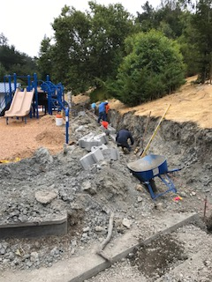
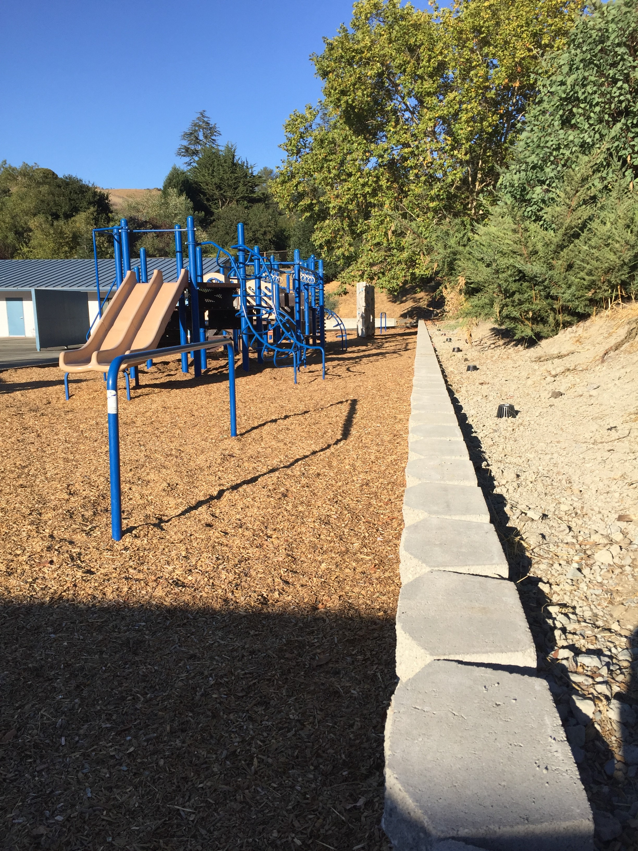
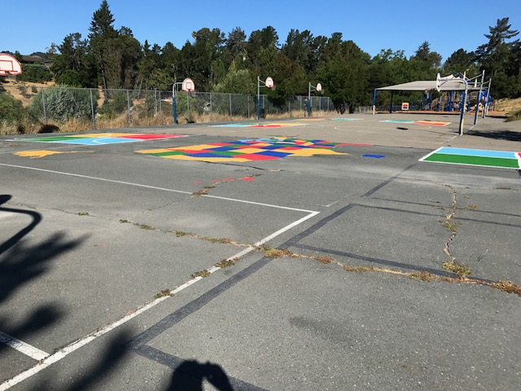
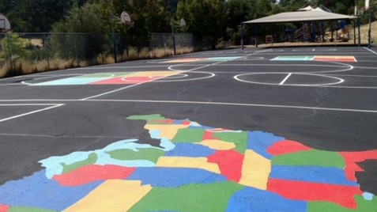
Recent Construction Activity
Camino Pablo School Retaining Wall, East Playground
Los Perales School Plaza de Amigo Playground

Slide 12
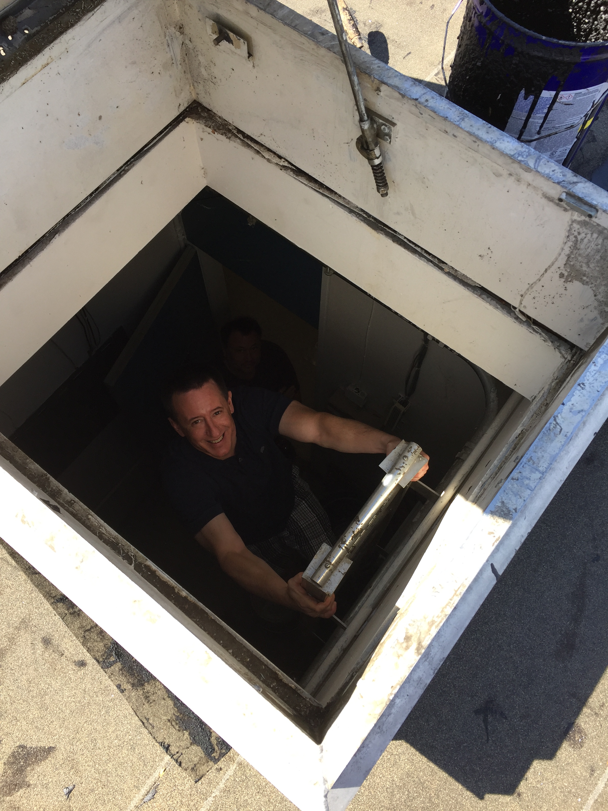
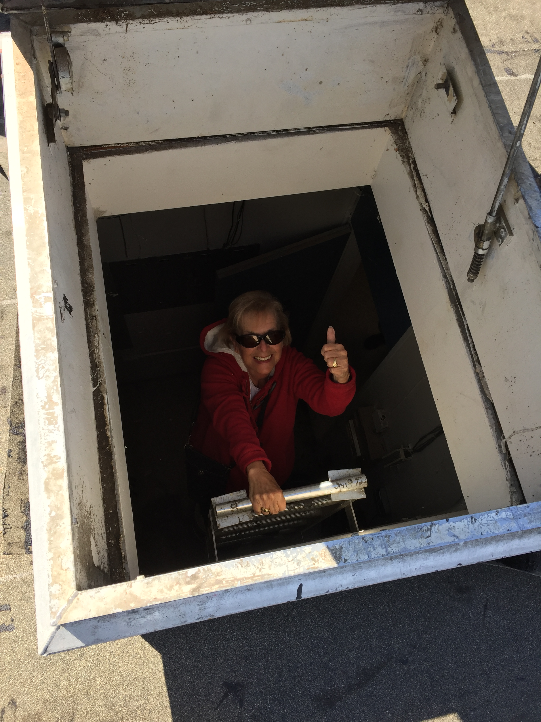
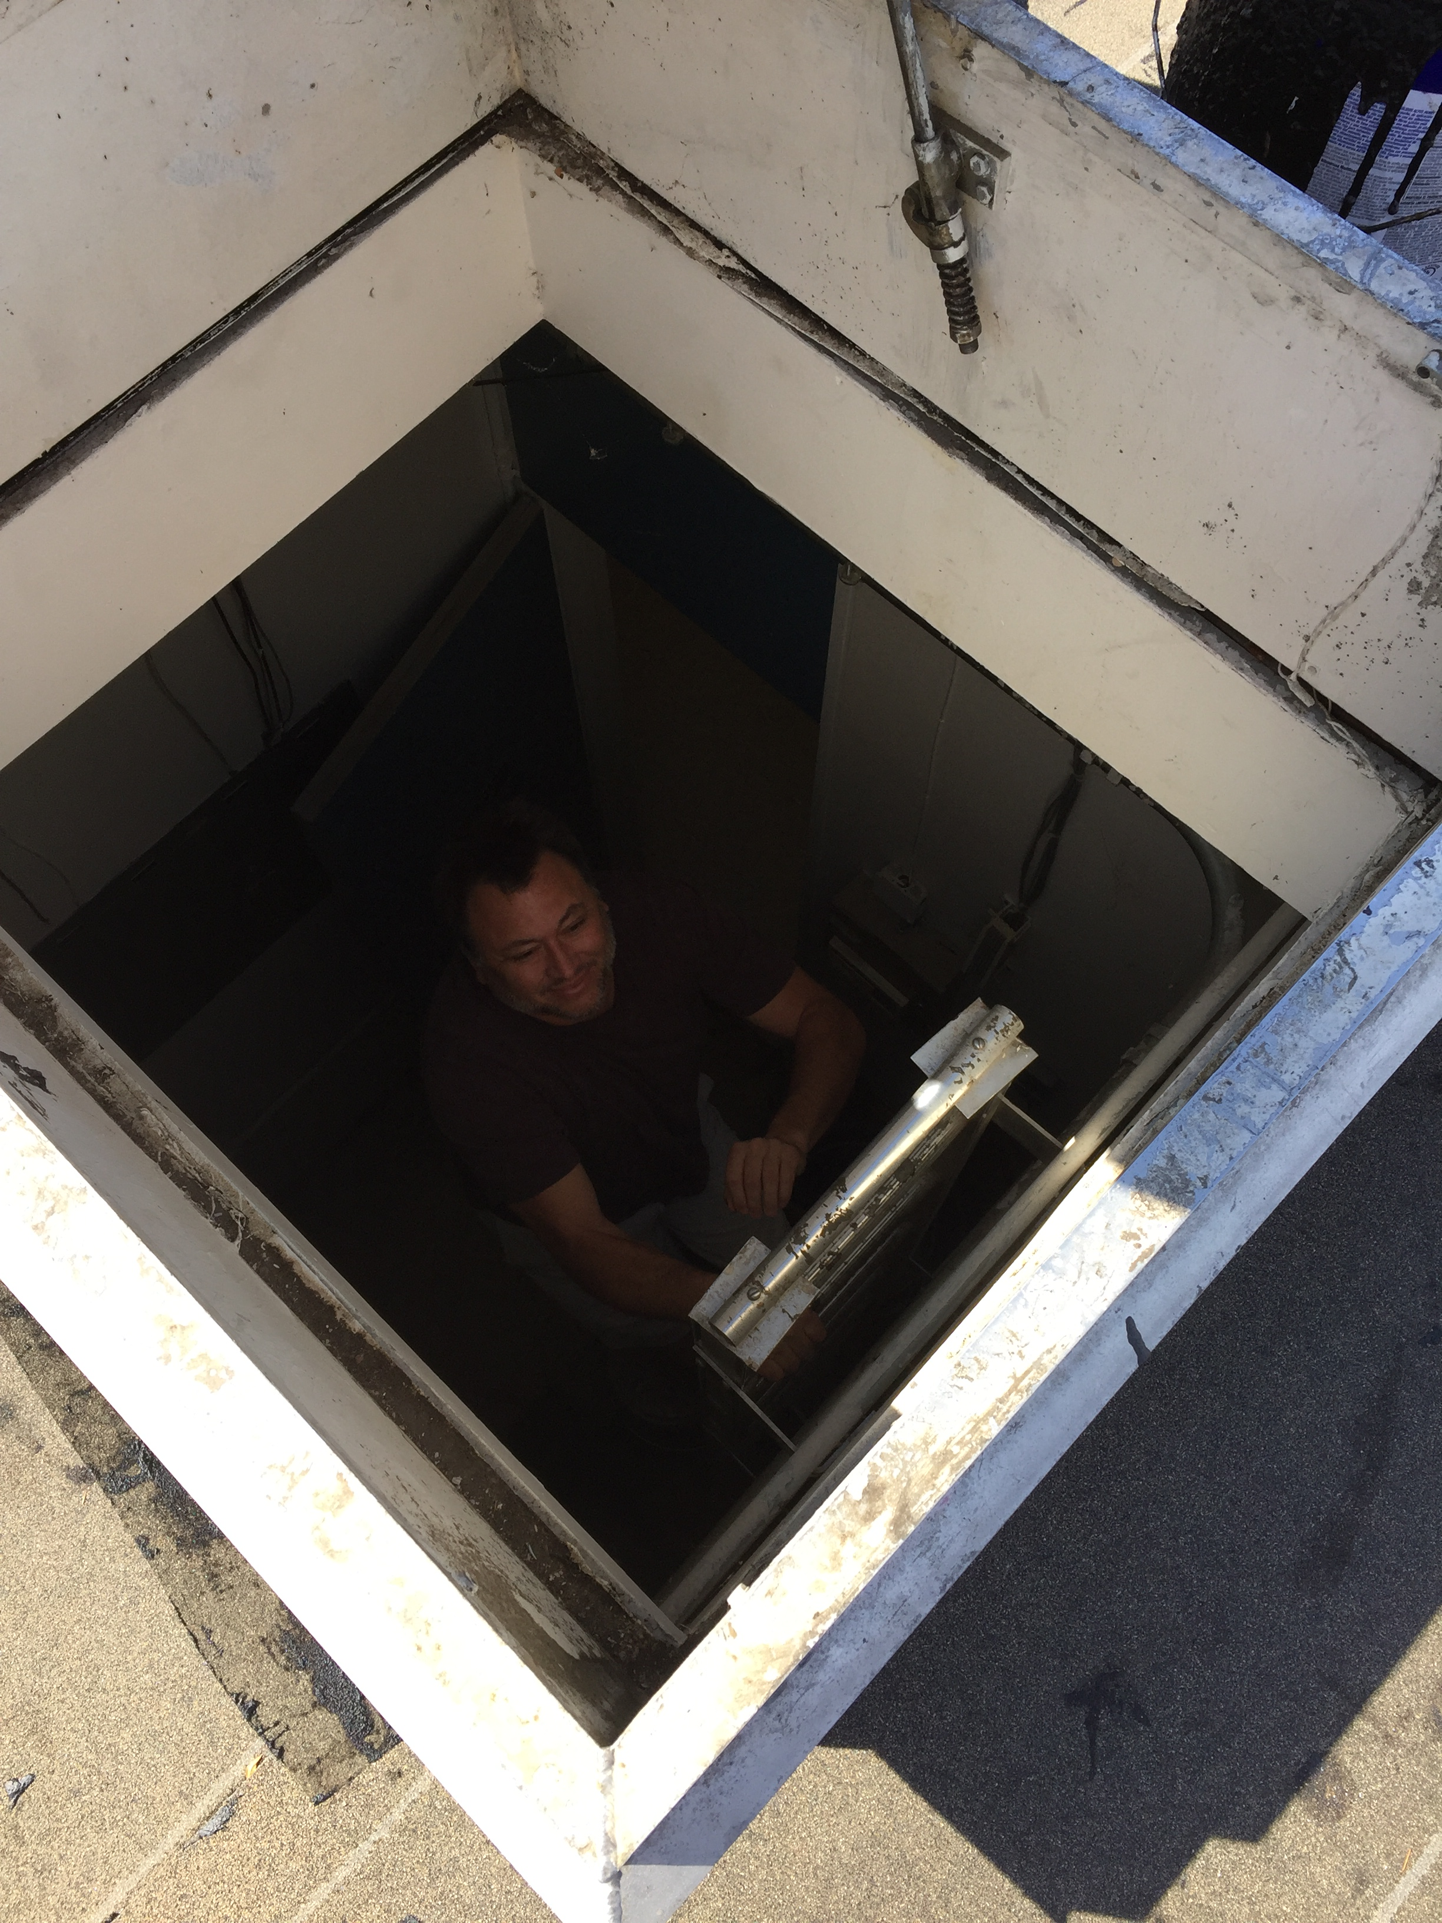
CBOC Inspection Team
Aaron, Lynette, Scott

Slide 13
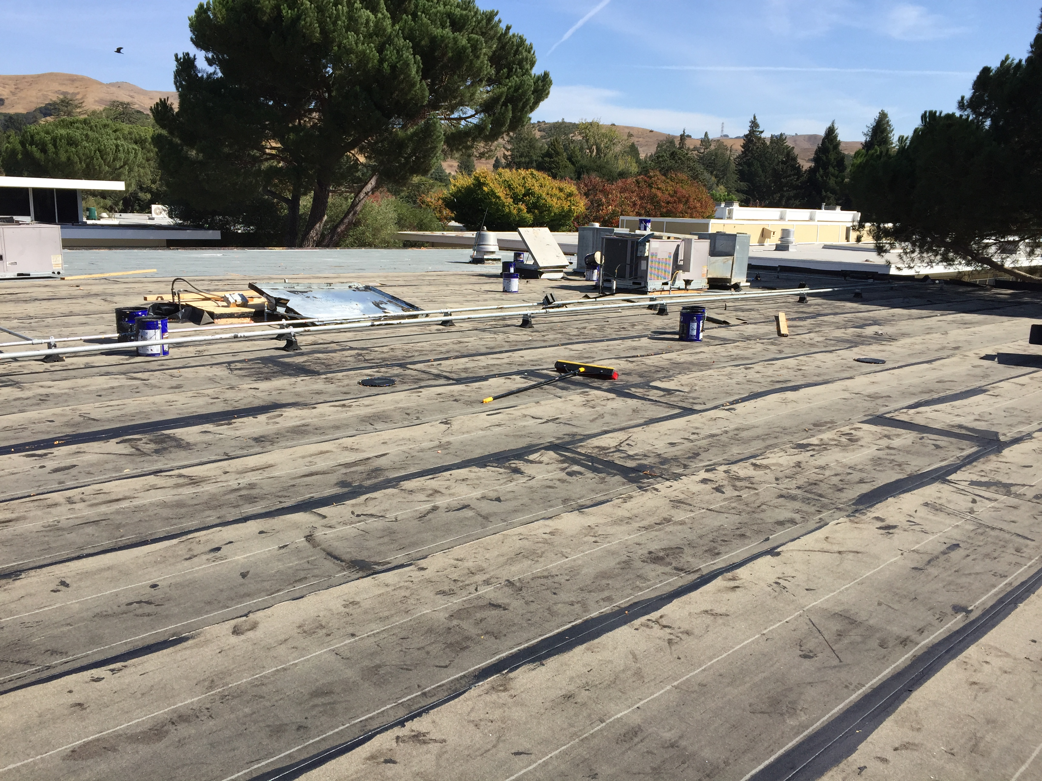
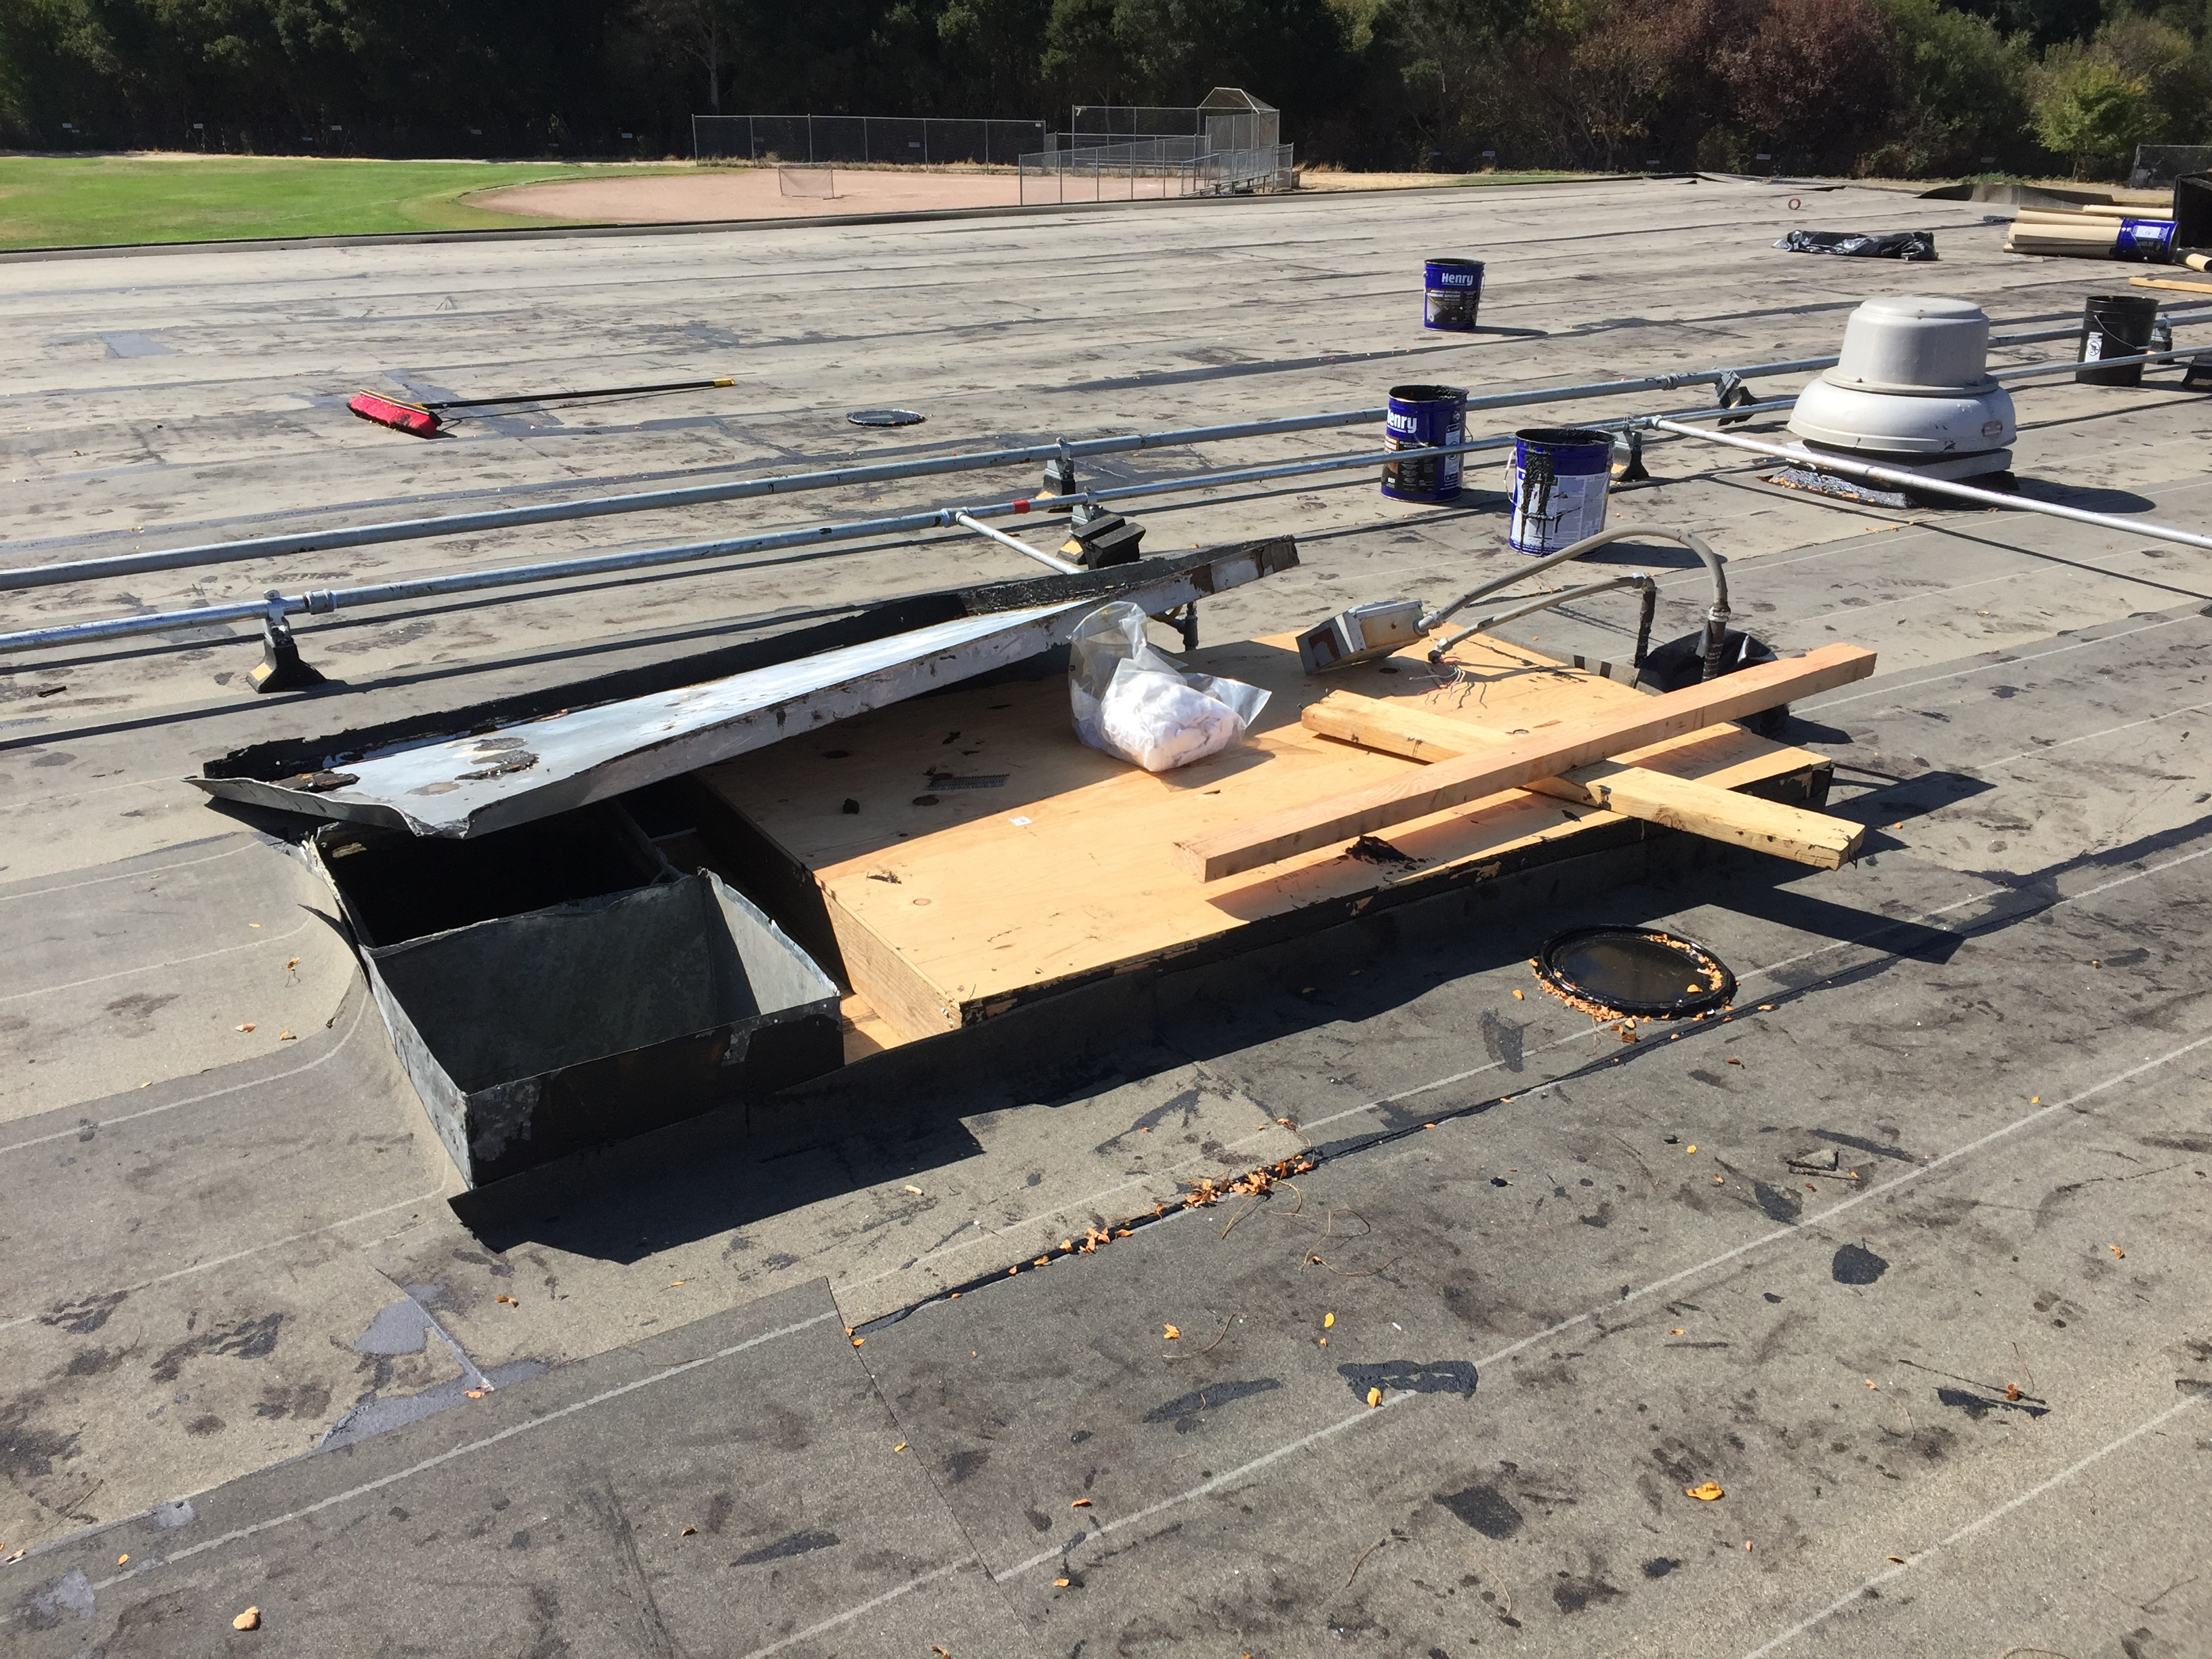
Recent Activity – JMIS Bldg G Roof Replacement
Mid Construction

Slide 14
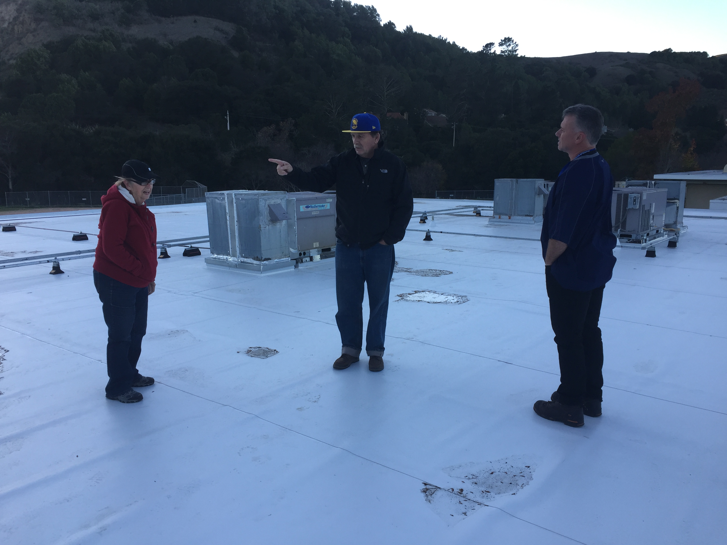
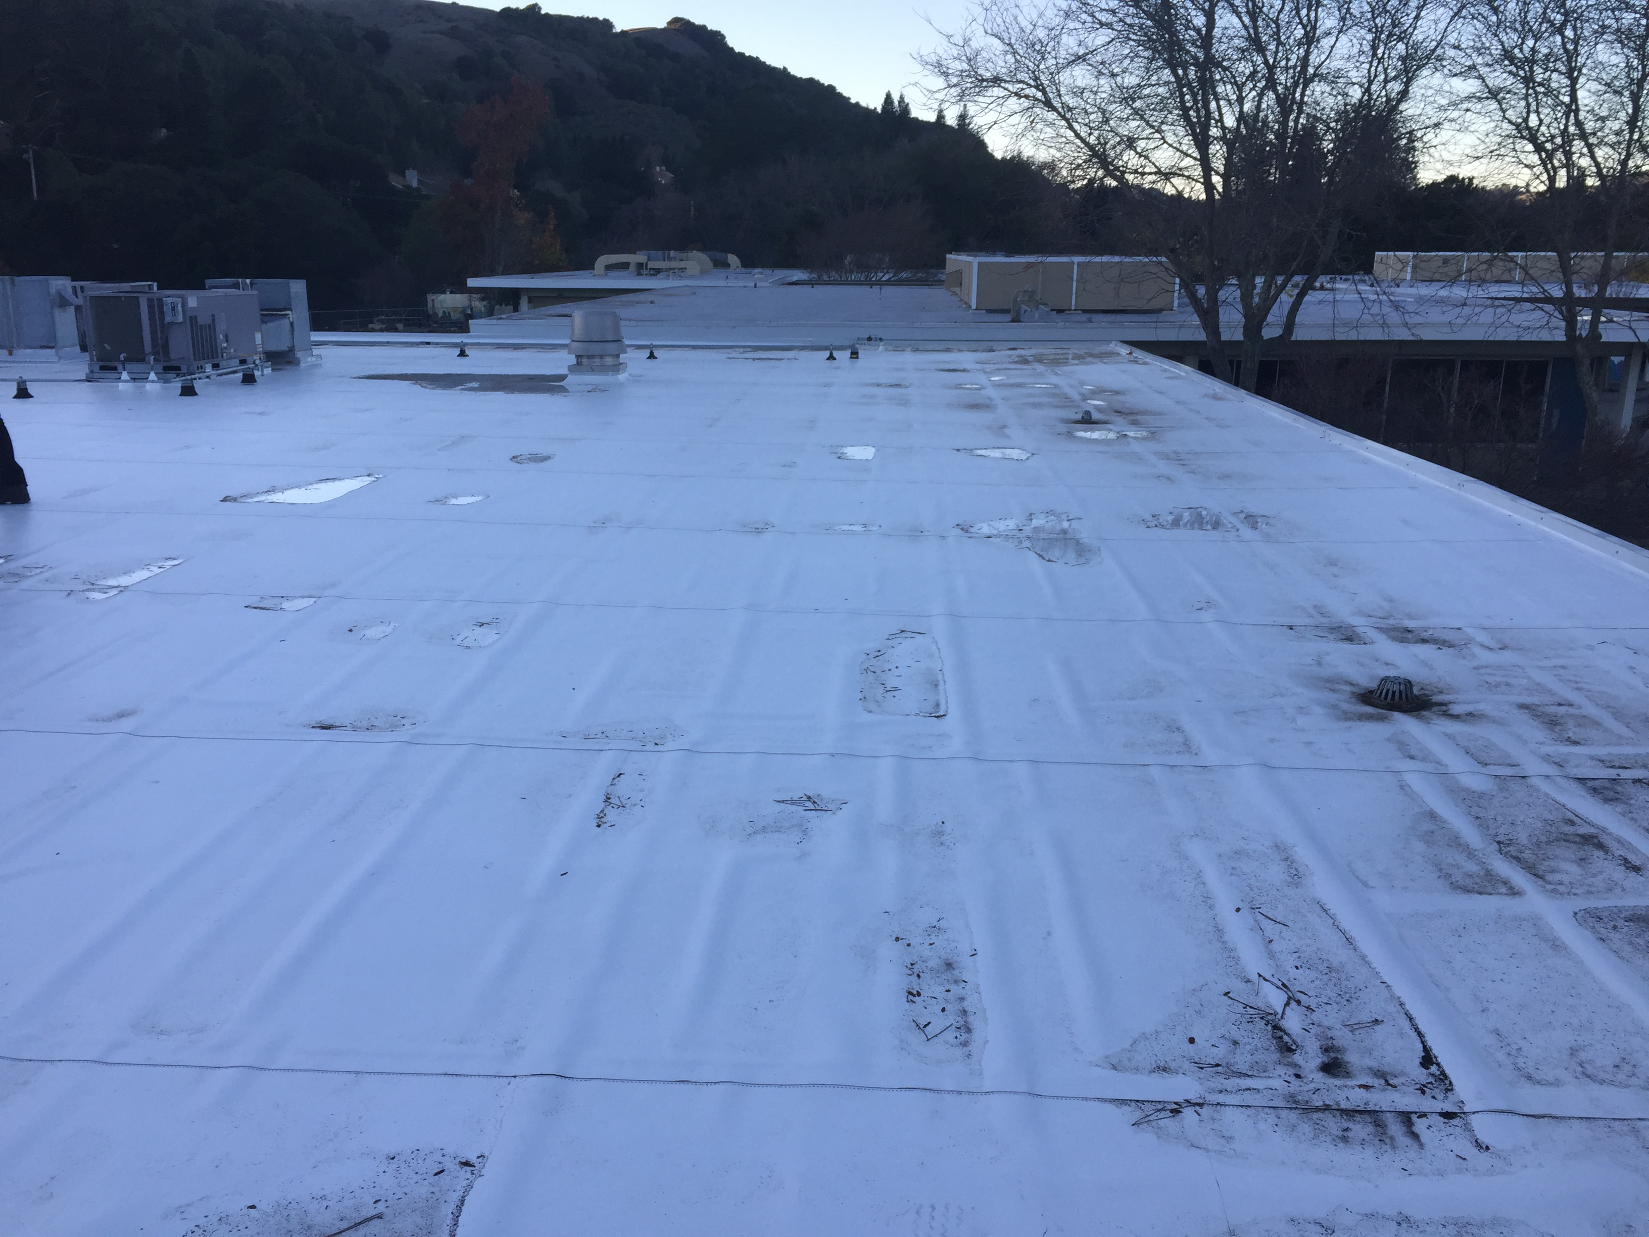
Recent Activity – JMIS Bldg G Roof Replacement
Post Construction

